Slide 1

Delta Team Animal Welfare Foundation(DTAWF) Shelter Management System.
Team Members:
Muhammad Mustofa Muntaseer(011201326)
Ashraful islam (011201324)
Mehedi hassan (011201323) Asif Raihan(011191139)

Slide 2
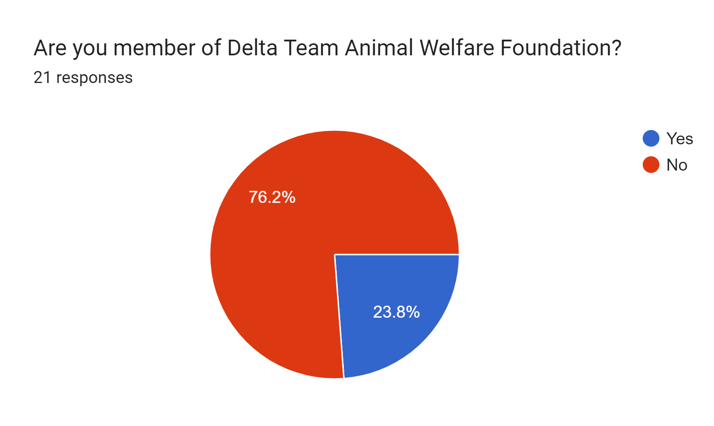
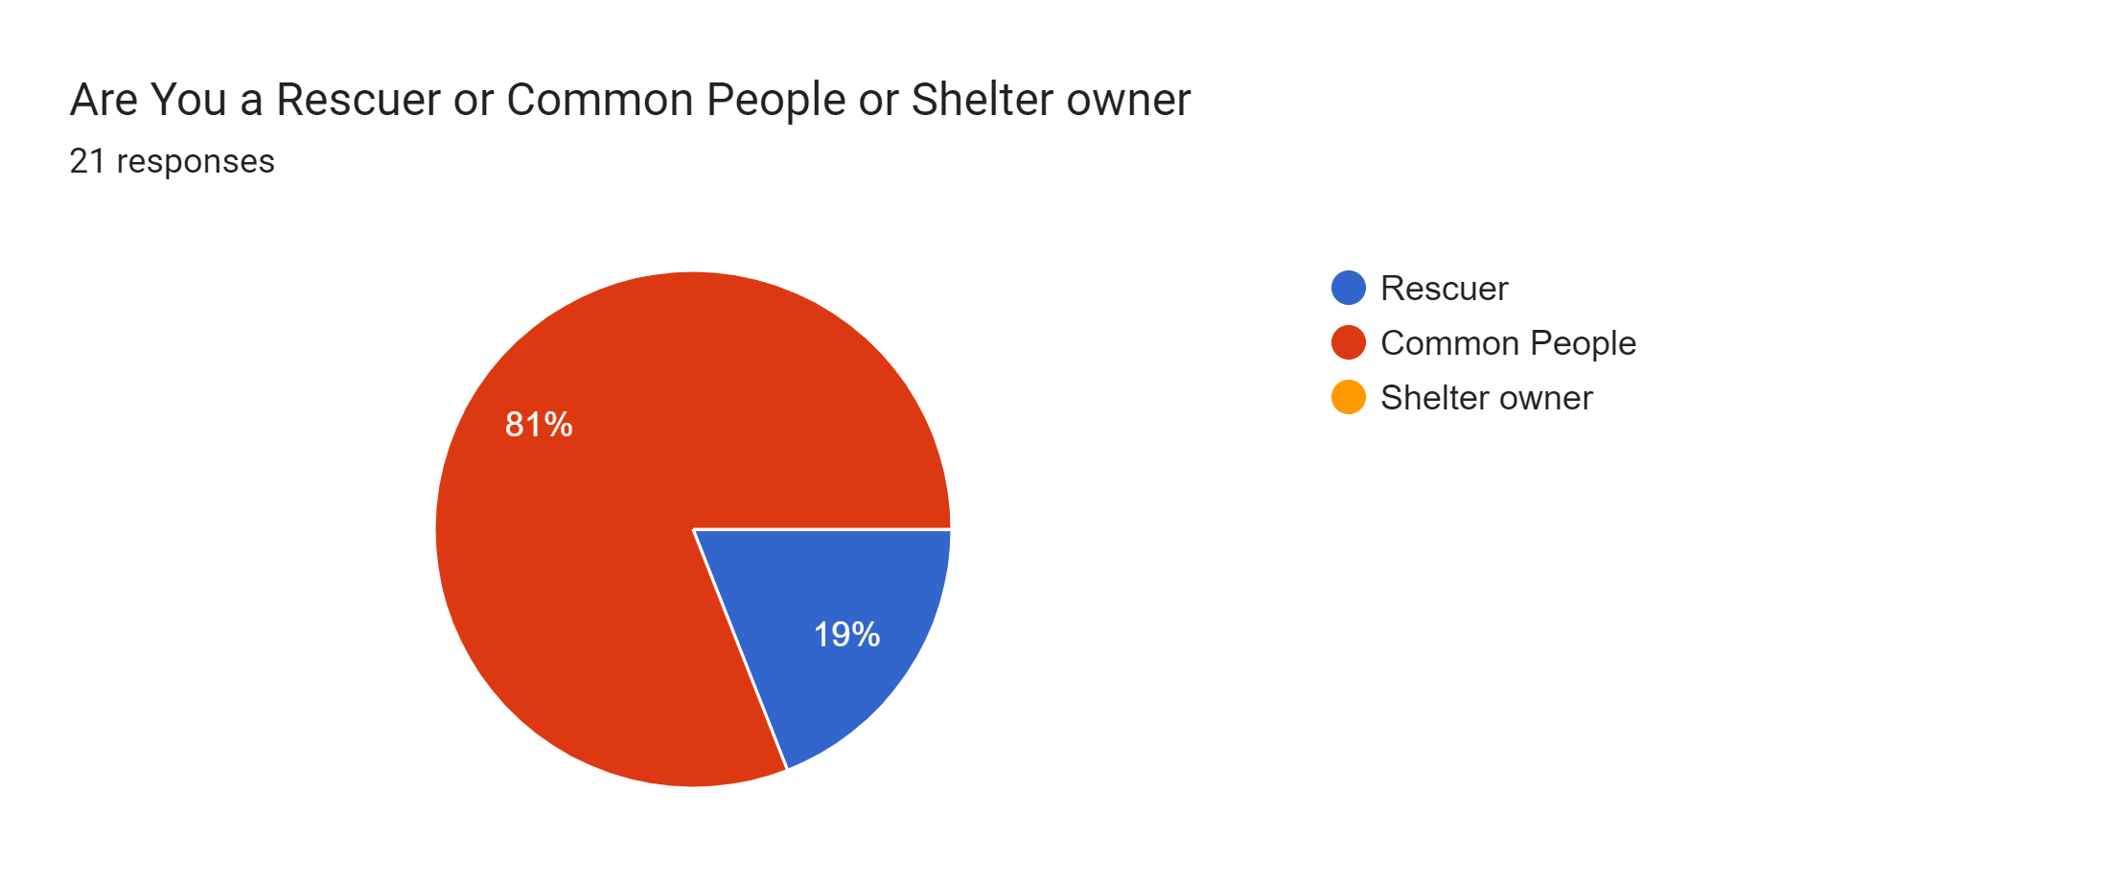
Survey Attendee Statistics
This project is very sensitive so our data needs to be presided. We gathered the information from the Animal Society and Our Foundation Members.
Fig:1.1
Fig:1.2

Slide 3
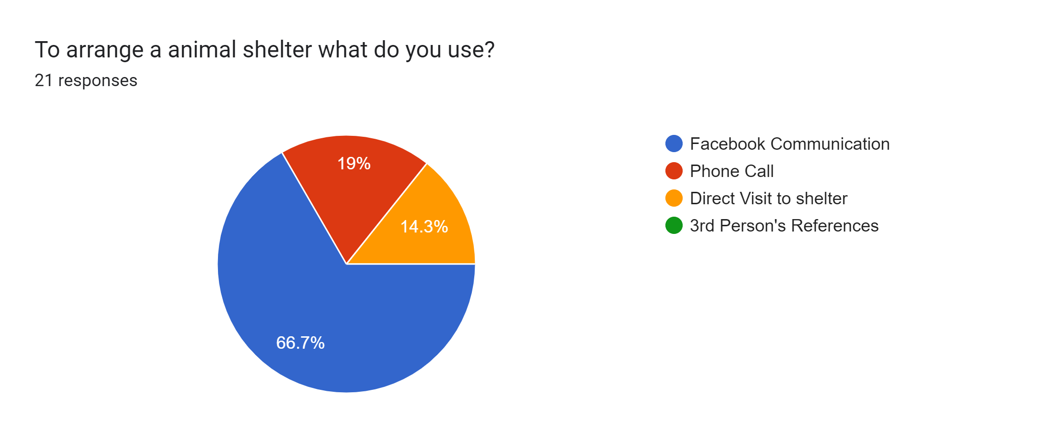
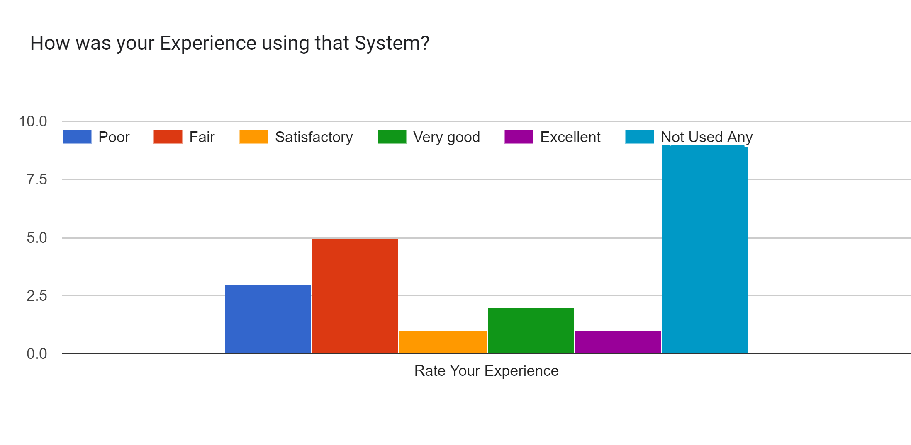
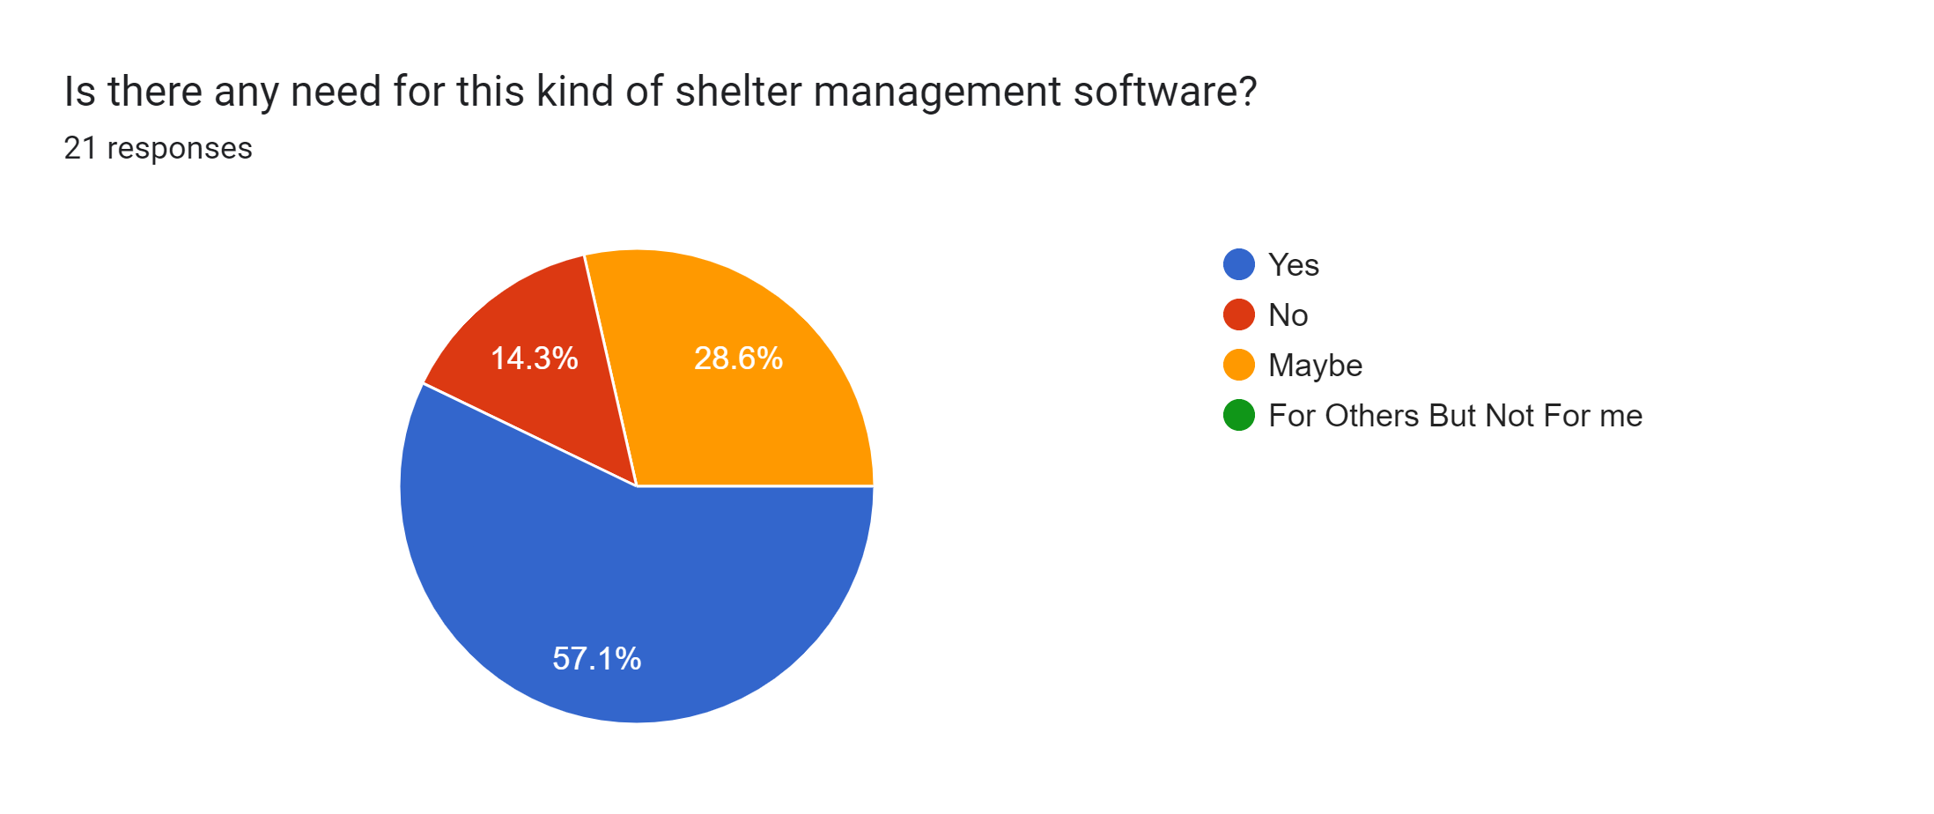
Survey Result: About The System
Fig:2.1
Fig:2.2
Fig:2.3

Slide 4
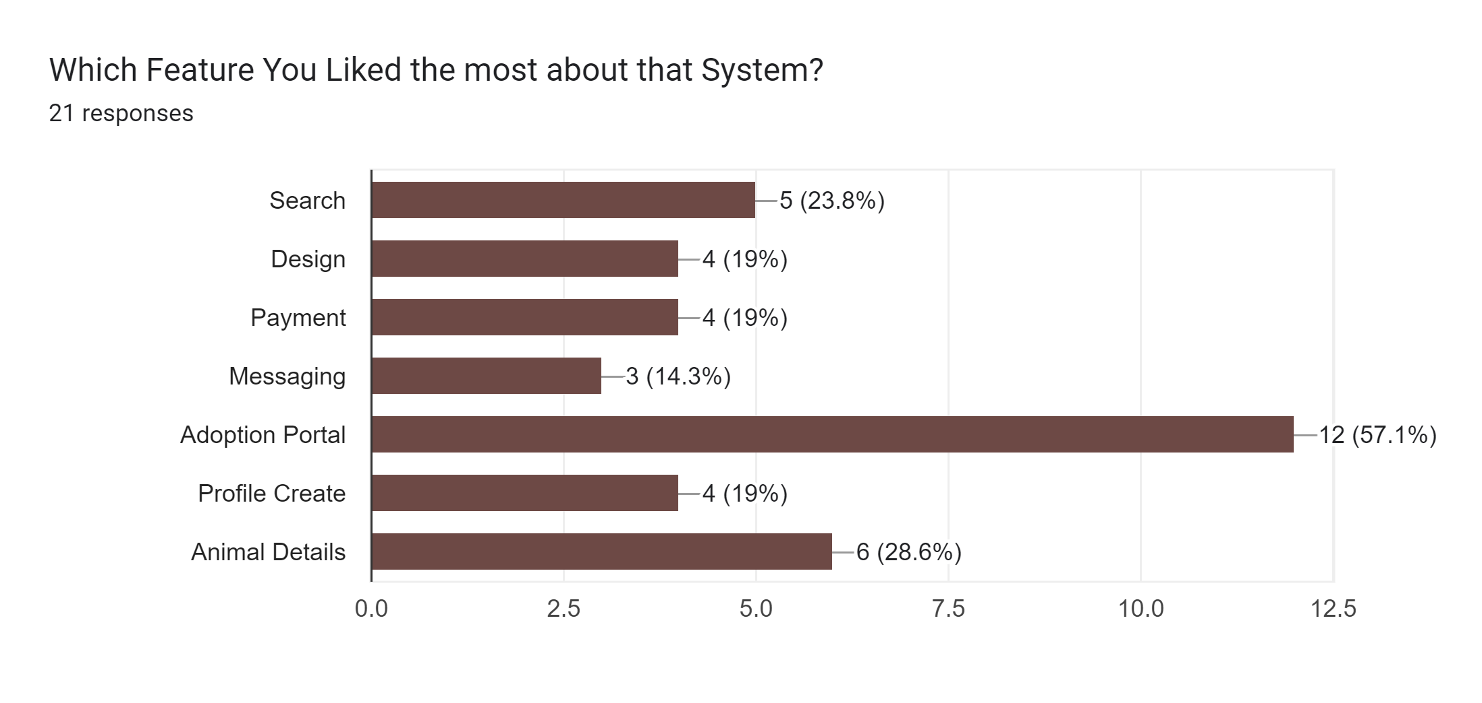
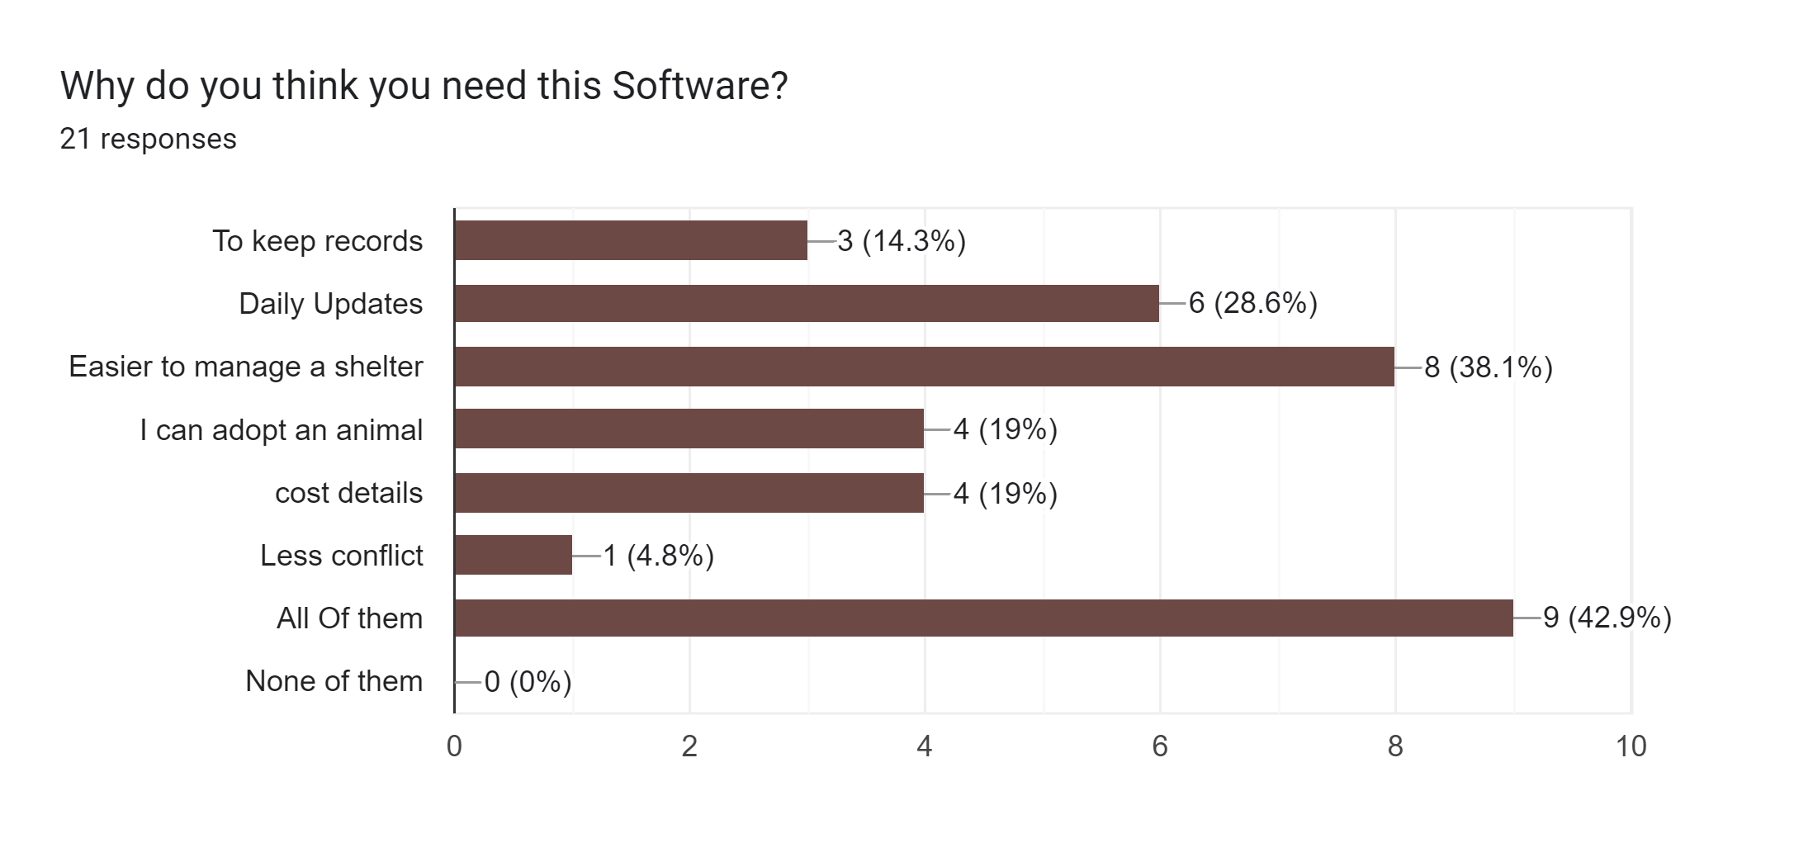
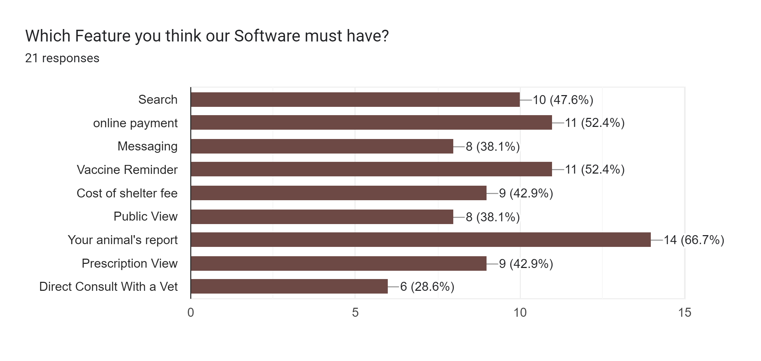
The Need & Reason
Fig:3.1
Fig:3.2
Fig:3.3

Slide 5
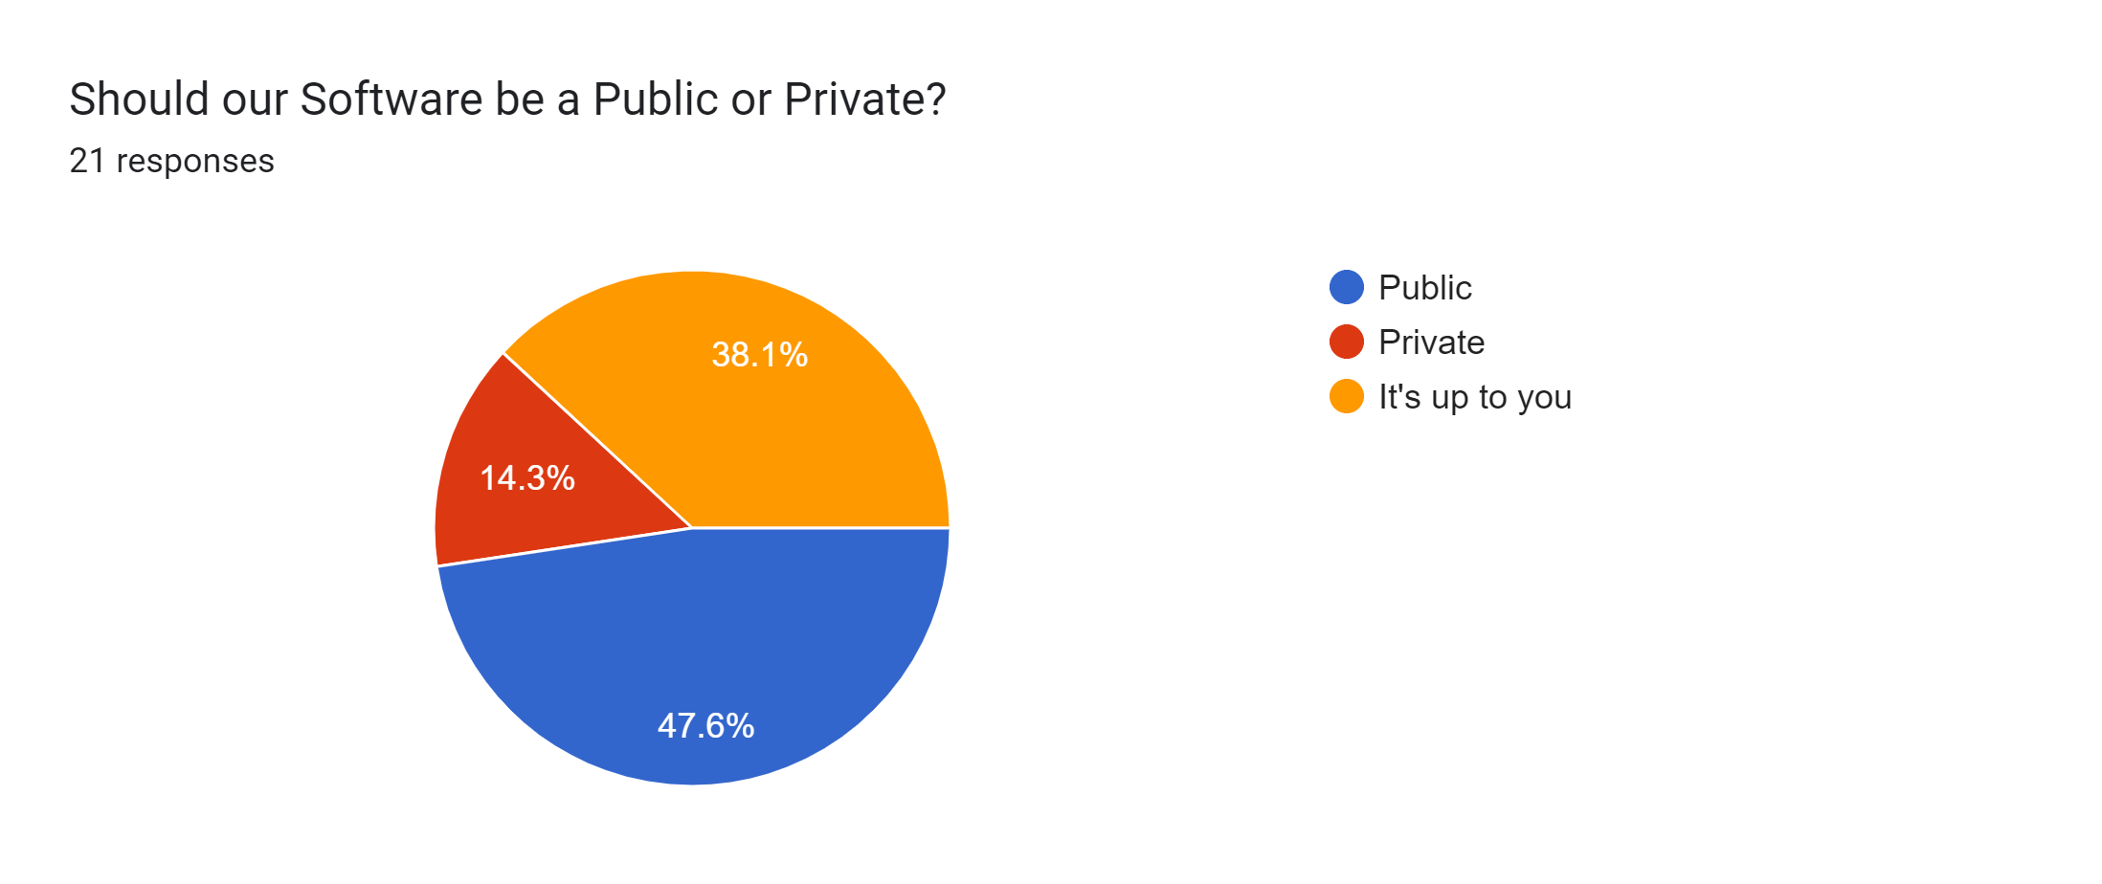
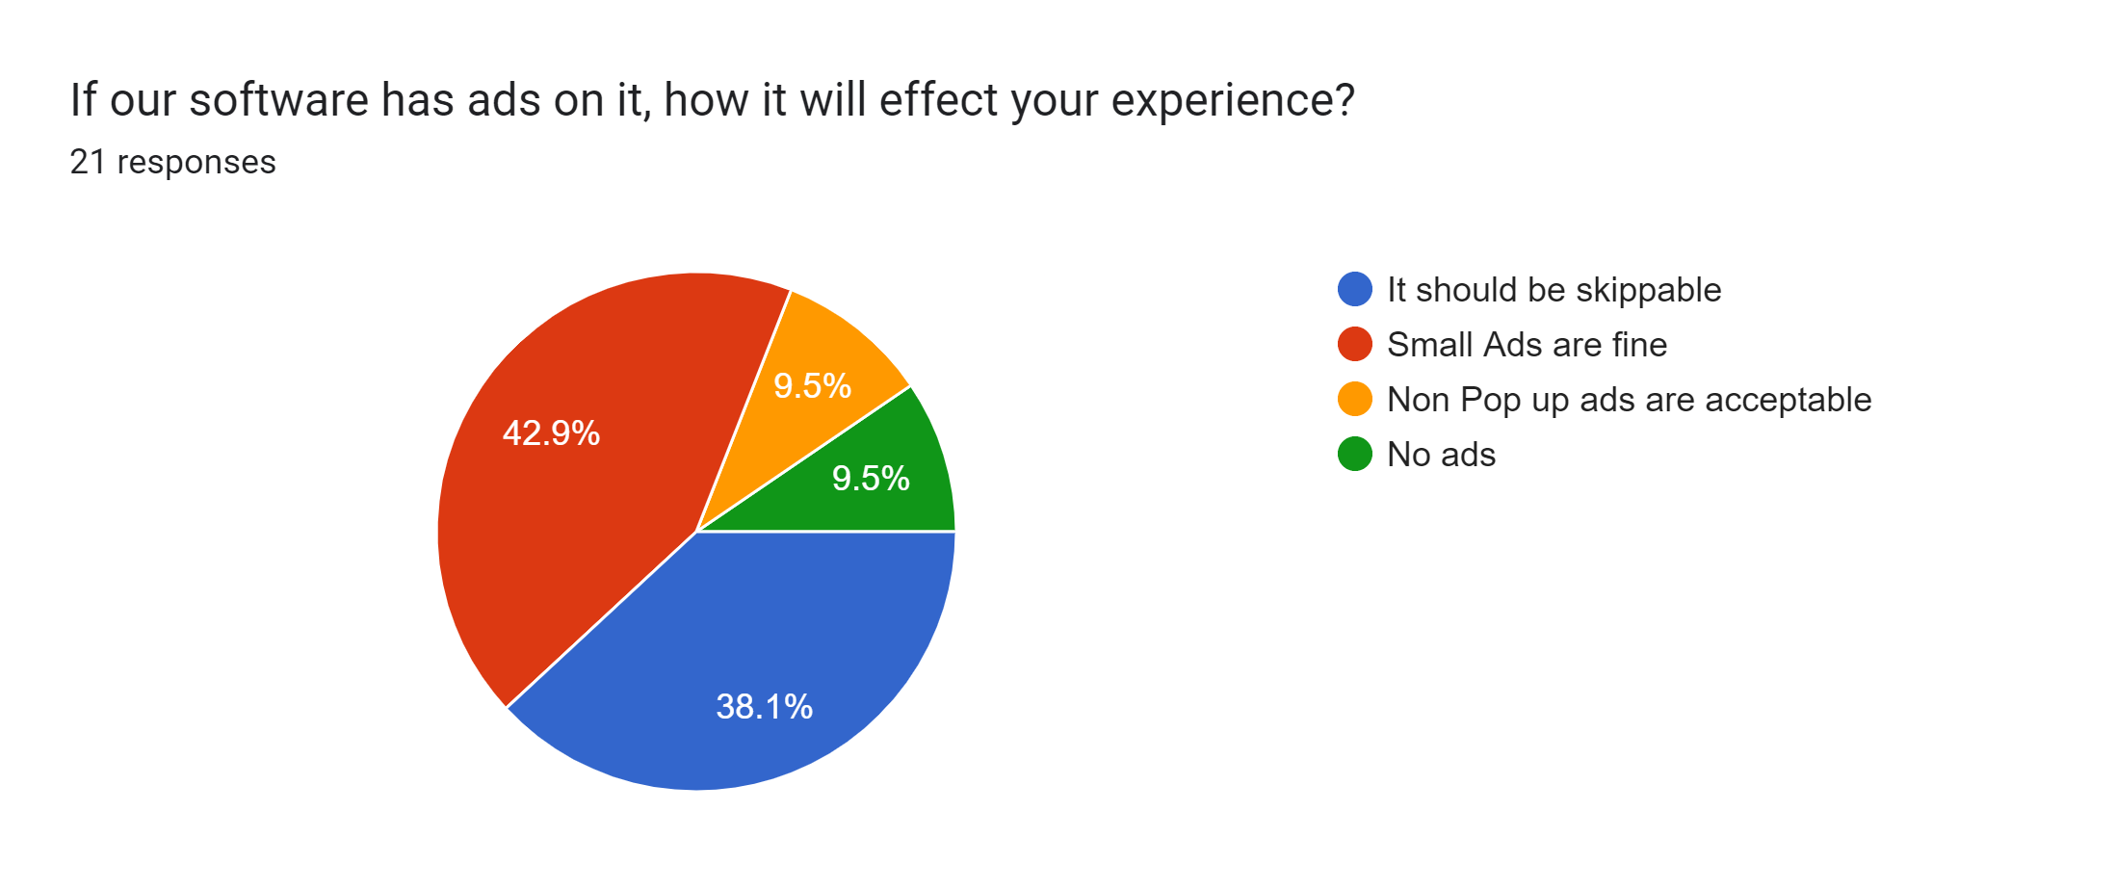
Finding another Possibility
Fig:4.1
Fig:4.2

Slide 6
List of Selected Features According to Fig 3.3
Features | Our Project
Online Payment | No 50%+(By Pass)
Public View | No 38%
Direct Consult With A Vet | No 28%
Prescription View | Yes 42%
Cost Counter | Yes 40%+
Search | Yes 45%+
Reminder | Yes 50%+
Report Generator | Yes 50%+
Fig:3.3
Messaging | N0 35%+

Slide 7
SWOT & Strategy
Our Strengths: Our System is unique because animal rescue sector is at it’s starting phase so this kind of system is new in this sector. It will bring a revolution.
Our Weakness: Our main weakness is we are armature in developing this kind of system with a better optimization.
Opportunities: Save time and effort for us and users. We can bring updated version frequently.
Threats: There are demand of Online payment and security but these are some higher level of development.
Strategy: Our system will have a limited users but it will be easier to use for a new users. We will develop it as anyone can use it. Core objective will be same but opportunities will be huge.

Slide 8
Thanks To You All

